Slide 1
IS400: Development of Business Applications on the Internet
Fall 2004
Instructor: Dr. Boris Jukic
Server Side Web Technologies: Part 1

Slide 2
Client Side vs. Server Side Web
Simply defined, client-side code executes on the end-user's computer, usually within a web browser.
Server-side code executes on the web server, usually within a web application environment, which in turn generates HTML to be viewed in a browser.

Slide 3
Client Side vs. Server Side Web
Which one to choose? What are the determining factors?
  Performance:
    Responsiveness, speed, reliability
    Ability to handle a large number of simultaneous users
  Functionality:
    Simplicity of use and maintenance,
    Breadth of user options
    Ability to handle multiple simultaneous transactions
  Security:
    Desktop security
    Server security
    Database security
    Network security

Slide 4
Client Side vs. Server Side Web
Examples:
  Code that runs on the server that interprets every mouse move and keystroke is clearly undesirable
    terminal to mainframe paradigm
  On the other hand, one does not want to download an entire product database to a browser and then run code that searches for the products.
  Server side forms have direct access to active code and perform more reliably
  On the other hand they are more prone to slowdowns due to the server/network congestion

Slide 5
Client Side vs. Server Side Web
In general, the key areas where client-side coding has advantages stem from its location on the user desktop and/or other end device. They include the following:
  Interactivity (e.g., mouse and keyboard handling)
  Handling of user interface controls: buttons, textboxes, etc.
  Feedback and validation
Key server-side strengths include stem from their proximity to the backend business databases and other applications. They include the following:
  Direct information access, retrieval, processing and storage
    facilitate e-commerce, reservations, shipment tracking etc.
  central repository of added web features such as e-mail, chat and multimedia streaming
  security and authentication (mostly)

Slide 6
Client Side Technologies
HTML : markup language for display of web content
  DHTML extensions for dynamic and interactive control of web page content and display (Not fully standardized by W3C yet)
  Tools for writing html documents include : Dreamveawer, FrontPage and any word processor (including Notepad)
JavaScript: client side programming language
VBScript: client side programming language (MS proprietary, supported by IE)

Slide 7
Client Side Technologies
Java Applets:
  small programs written in Java, embedded in an HTML page and executed from within a browser
  Unlike JavaScript, the Java code must be pre-compiled into a so-called bytecode before it can be interpreted by a browser’s so–called Java Virtual Machine
  In other words, the Notepad and the browser alone are not enough to write java applets

Slide 8
Client Side Technologies
ActiveX controls
  Similar to Java Applets but can be written in a variety of programming languages such as C, C++, VB and even Java
  Supported by Windows only
  Security issues: unlike Java applets, ActiveX controls have full access to all desktop resources: memory, operating systems, …
    Authentication and registration system

Slide 9
Client Side Technologies
Macromedia Flash
  Proprietary commercial application for creating interactive graphic content
  It has its own scripting language
  To reproduce the Flash content browsers must be equipped with a Flash Player plug-in

Slide 10
Client Side Technologies: summary
Client Side technologies have evolved form a simple tools for creating static pages to sophisticated array of technologies turning a browser into a powerful multifunctional client
Consequently, we can stop referring to a web client as “thin” client (i.e. limited in size and computational needs)

Slide 11
Server Side Technologies
Server-side technologies are quite numerous and diverse. Popular server side web application technologies include:
Microsoft ASP/.NET
Java server technologies such as J2EE, JSP, and servlets
CGI / Perl
PHP
ColdFusion

Slide 12
Server Side Technologies
In addition, the server-side technologies include database systems such as Oracle, SQL Server (Microsoft), MySQL (open source) and many others
  DB systems are indispensable part of server side operations and some DB software providers, such as Oracle are combining web application functionality with their core database functions

Slide 13
Server Side Technologies
The “core” server side application development platforms can retrieve, modify and query the contents of databases through their own access mechanisms:
    ADO.NET for Microsoft’s .NET platform enables access to almost every existing database platform
    php enables direct access to many existing DB platforms, most notably MySQL, but also, Oracle, SQL Server and others

Slide 14
Server Side Technologies: ASP/.NET
.NET is Microsoft framework supports many programming languages such as VB, C++, C#, JScript
  One application can have components written in multiple languages
ASP.NET (Active Server Pages) is an integral part of .NET initiative
  It is a technology for creating dynamic web content on the server that appears as HTML on a client’s browser
  Developers can use this technology to write scripts in a language of their choice for from processing, interactive web pages, or any other dynamic content
Every element in an ASP.NET page is treated as an object and run on the server.
ASP.NET server controls are components that can perform the same work as HTML controls: radio buttons, text boxes, buttons, etc.
Unlike HTML controls, ASP.NET controls preserve their content if and when this is needed

Slide 15
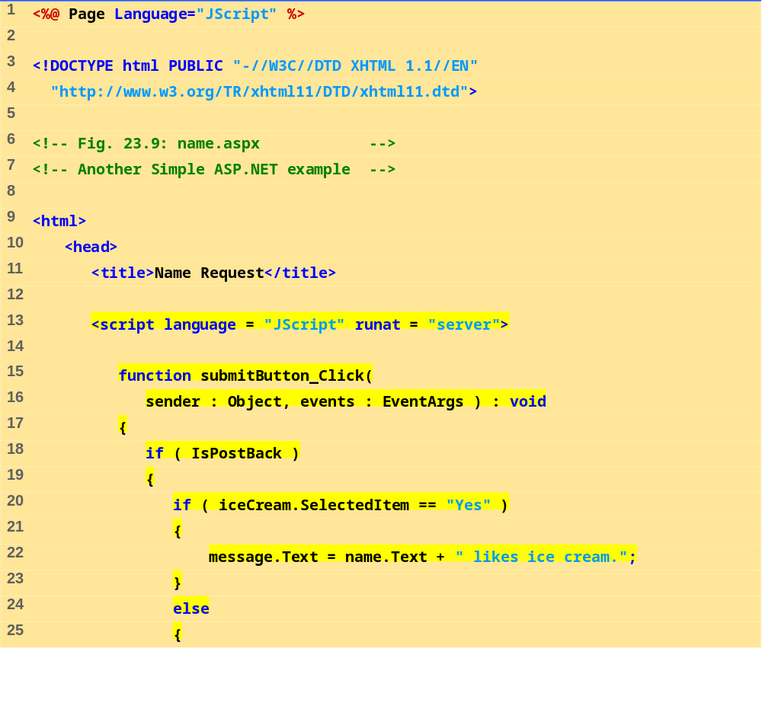

Slide 16
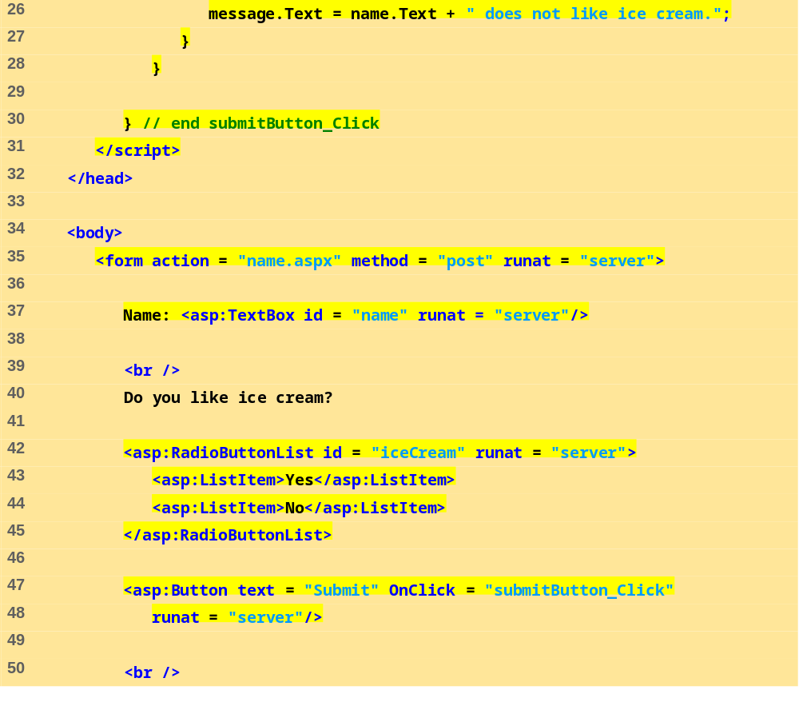

Slide 17
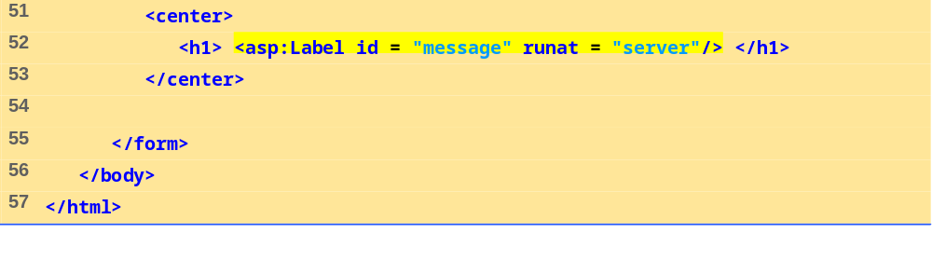
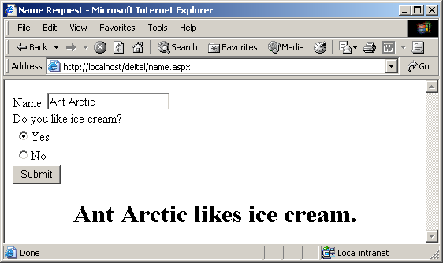

Slide 18
Server Side Technologies: ASP/.NET
Session Tracking
If the server (Web Host) running the server side script interacts with multiple clients (such as multiple customers buying goods at Amazon.com, for example)
If interaction requires more than one http page request:
  in essence more than one click of the button is needed to process a transaction
The problems of session tracking is caused by the fact that the HTTP protocol is stateless
  Every page load is a new event without memory of any previous events
Not acceptable for any web application that is spread over the series of page loads, such as on-line shopping, catalog browsing, registration and large form entry pages, on-line questionnaires
Two most common solutions
  Cookies
  Session Identifiers

Slide 19
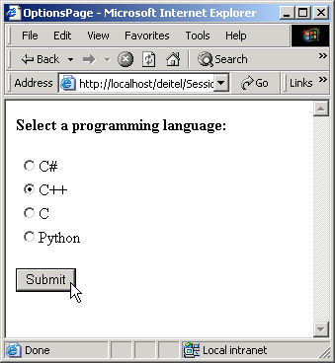
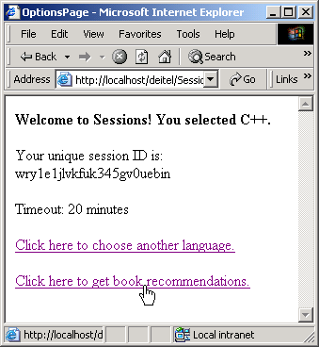

Slide 20
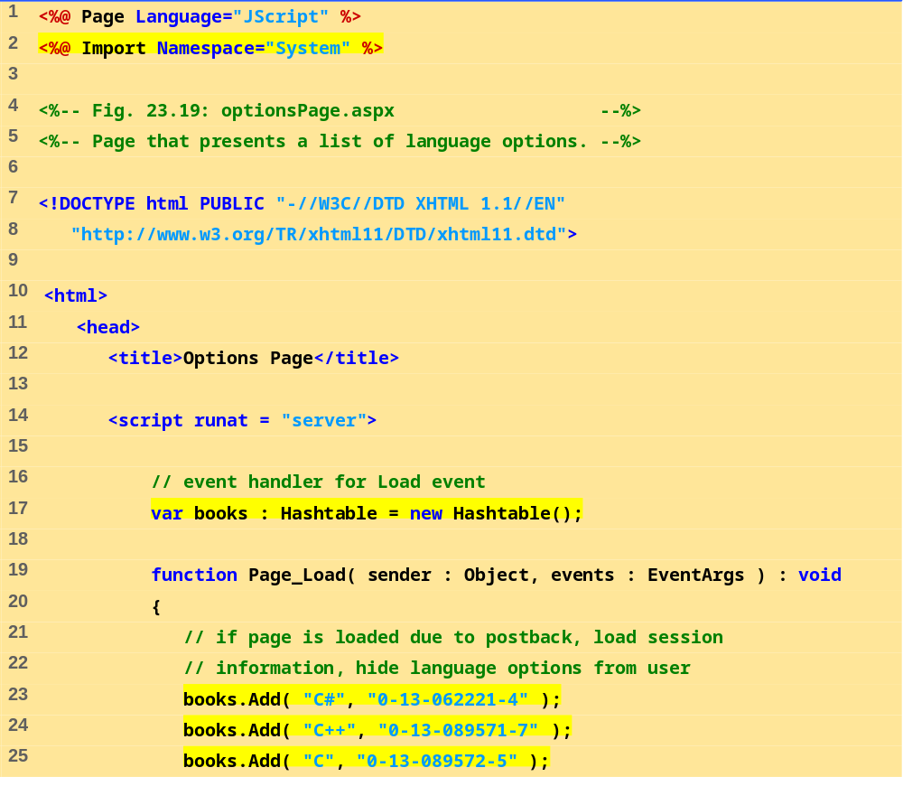
optionsPage.aspx
(1 of 6)

Slide 21
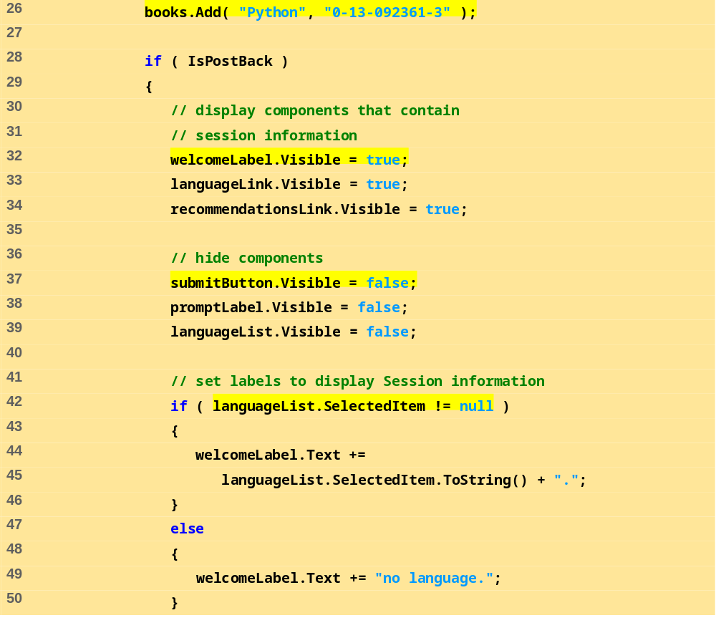
optionsPage.aspx
(2 of 6)

Slide 22
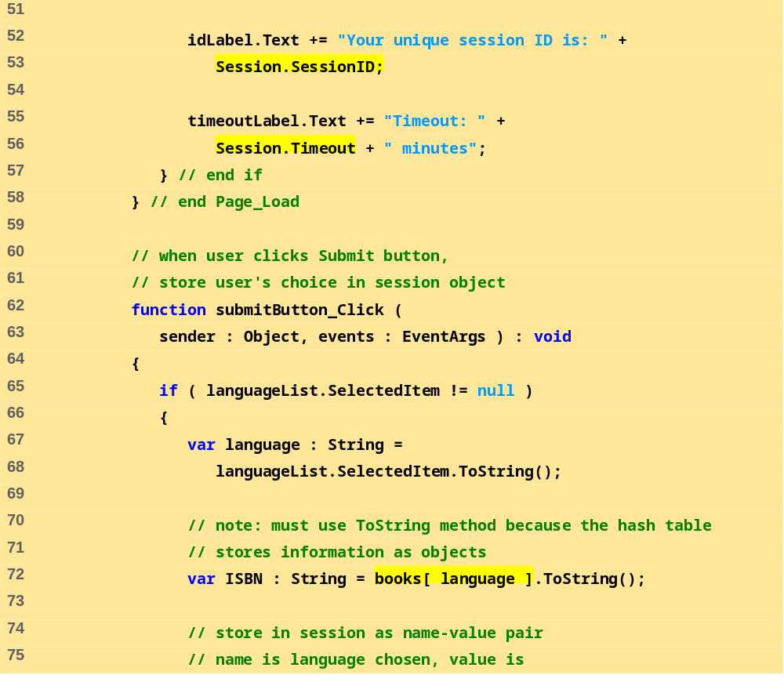
optionsPage.aspx
(3 of 6)

Slide 23
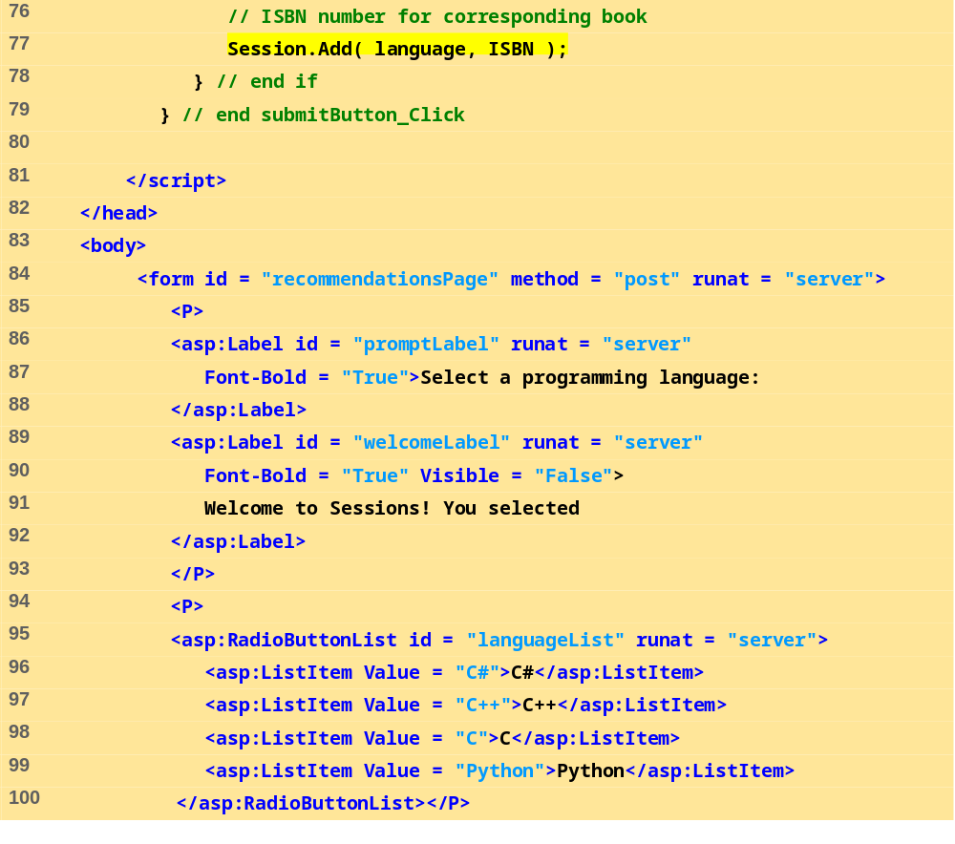
optionsPage.aspx
(4 of 6)

Slide 24
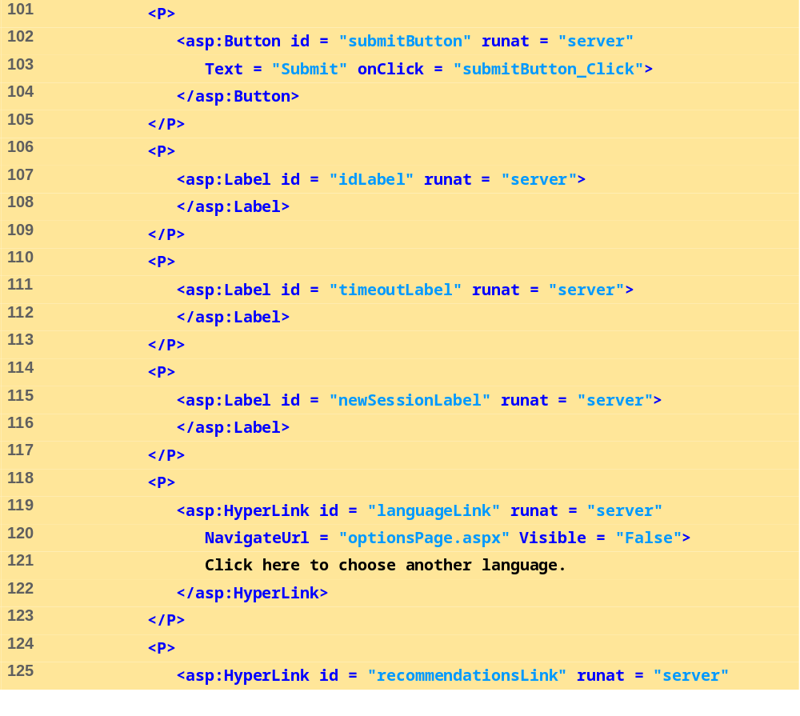
optionsPage.aspx
(5 of 6)

Slide 25
